Slide 1

E-Learning System
Upadrasta Harsha Vardhan
Ummidi Shiva Kalyani
sireesha nadipalli
Shivani Koppisetti
S TILAK REDDY
sindhu aiatharappagari

Slide 2
Abstract
This innovative software project is an effective E-Learning System .E-learning is an education via the Internet, network, or standalone computer. E-learning is basically the network- enabled convey of skills and knowledge. E-learning refers to using electronic applications and processes to learn.E-learning includes all forms of electronically supported learning and teaching. The information and communication systems,whether networked learning or not, serve as specific media to implement the learning process. In this new era of electronics, we know the concept of e-learning which does not include the use of paper and pen. There are many advantages of e-learning system. In this e-learning system we can assign projects to students and can share documents and more easily.

Slide 3
Introduction
In this new era of electronics, we know the concept of e-learning which does not include the use of paper and pen. There are many advantages of e-learning system. In this e-learning system we can assign projects to students and can share documents and more easily. This system has three modules including student, faculties and Admin. Students can login, they have access to main menu,projects, documentation, to upload, view the things uploaded by the faculties, knowledge books, also send messages to faculties. Faculties can login and have access for viewing, uploading documents and projects. Admin can login and manage the faculties and student details and also view projects. This is how the new concept of e-learning came into existence, which is an easier and smarter system for colleges.

Slide 4
Modules
Student
Admin
Faculty

Slide 5
Responsibilities
User/Student
Login: User can login his account using id and password.
Main Menu: User will have access of main menu.
Calendar: Can see the calendar
Projects: user can view the projects.
My Project: user can see previous uploaded projects.
Documentation: User can do documentation.
Upload: User can upload the documents and project.
View: user can also view the documentation.
Knowledge: User read the knowledge articles uploaded.
Chat: User can chat to obtain information.

Slide 6
Faculty
Login: Faculty can login his account using id and password.
Documentation: Faculty can do documentation
Upload: Faculty can upload documents
View: Faculty can view all the documents
View Projects: Faculty can view projects uploaded by students.

Slide 7
Admin
Login: Admin can login using credentials.
Manage Faculty: Admin can manage faculties.
Manage Student: Admin can manage students.
View Projects: Admin can view projects uploaded by students.

Slide 8
Motivation
With the advent in technology and with the perpetual increase in the strength of the students and the number of departments in the educational institutions ,it is laborious to exchange the study materials between the students and faculties. The main objective of the E-learning is to help students get over the traditional methods of learning and make them accustomed to the internet where the notes for their respective subjects are easily available.

Slide 9
SYSTEM REQUIREMENTS
Functional Requirements
Hardware requirements
Computer with:-
• 256 MB RAM but 1 Gig preferred
• Internet access at 56k or above
• 3 GB of hard disk space
• Screen resolution min 1024 x 768
Software requirements
• Internet Explorer 7.0+, Safari 3.0+, Firefox 3.0+
• Windows 7, Vista, or XP; Mac OSX 10.4+
• IE 7.0+, Safari 3.0+, Firefox 3.0+ (Browser must be Java and JavaScript enabled)
• System development software: - visual studio (java), SQL server.

Slide 10
Implementation Details
Java
Java is a MUST for students and working professionals to become a great Software Engineer specially when they are working in Software Development Domain. Java is a MUST for students and working professionals to become a great Software Engineer specially when they are working in Software Development Domain. I will list down some of the key advantages of learning Java Programming:
Object Oriented
Portable
Architecturally Neutral
Simple
Secure
Platform Independent

Slide 11
Java AWT
Java AWT (Abstract Window Toolkit) is an API to develop Graphical User Interface (GUI) or windows-based applications in Java.
Java AWT components are platform-dependent i.e. components are displayed according to the view of operating system. AWT is heavy weight i.e. its components are using the resources of underlying operating system (OS).
The java.awt package provides classes for AWT API such as TextField, Label, TextArea,RadioButton, CheckBox, Choice, List.

Slide 12
Java swing
Java Swing is a part of Java Foundation Classes (JFC) that is used to create window-based applications. It is built on the top of AWT (Abstract Windowing Toolkit) API and entirely written in java.
Unlike AWT, Java Swing provides platform-independent and lightweight components.
The javax.swing package provides classes for java swing API such as JButton, JTextField, JTextArea, JRadioButton, JCheckbox, JMenu, JColorChooser etc.

Slide 13
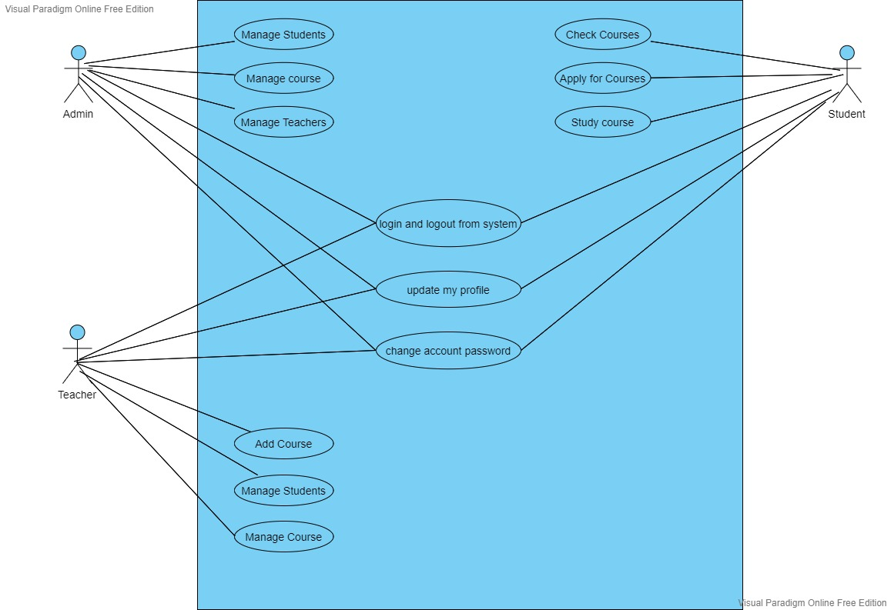
Uml Diagrams Usecase Diagram

Slide 14
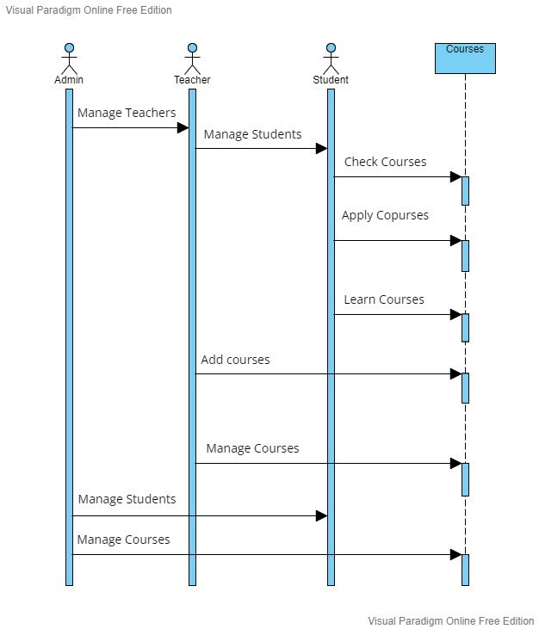
Sequence Diagram

Slide 15
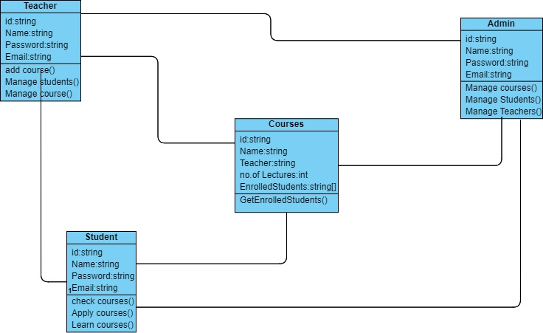
Class Diagram

Slide 16
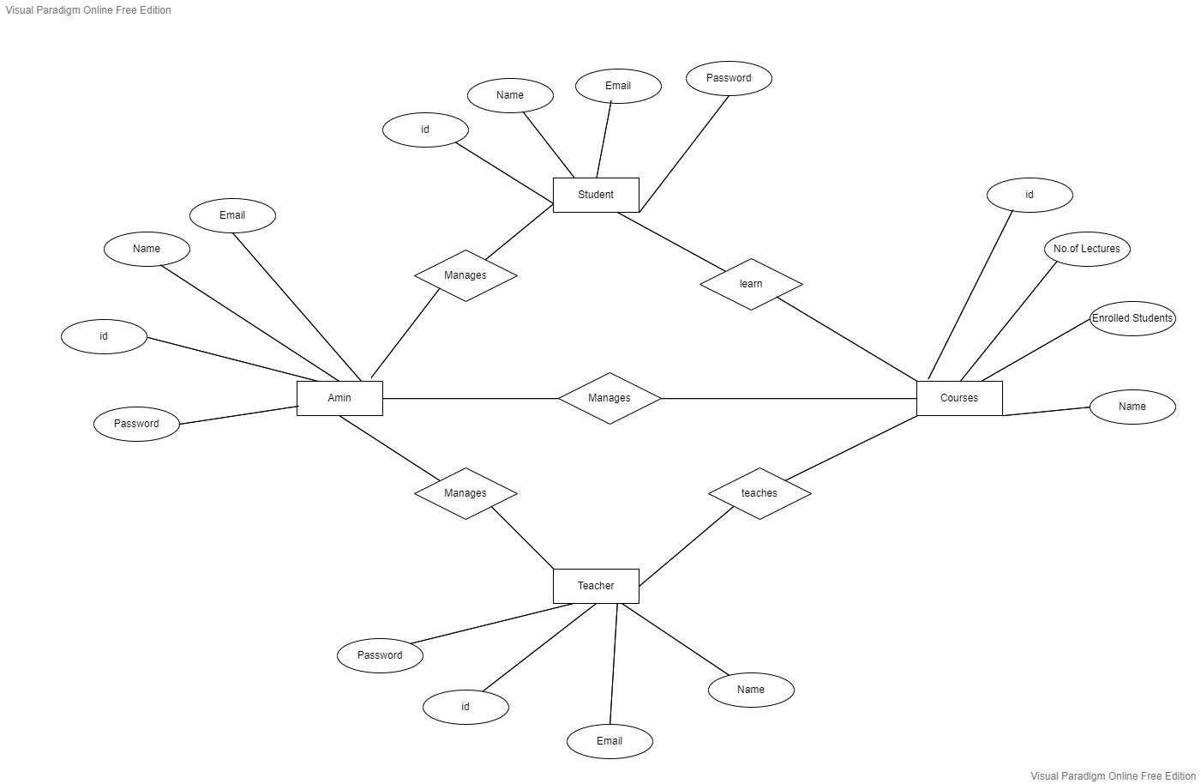
E-R Diagram

Slide 17
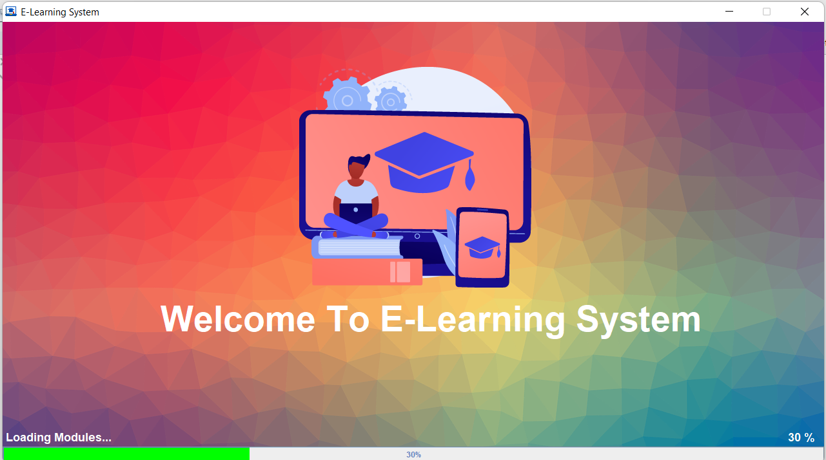
Output

Slide 18
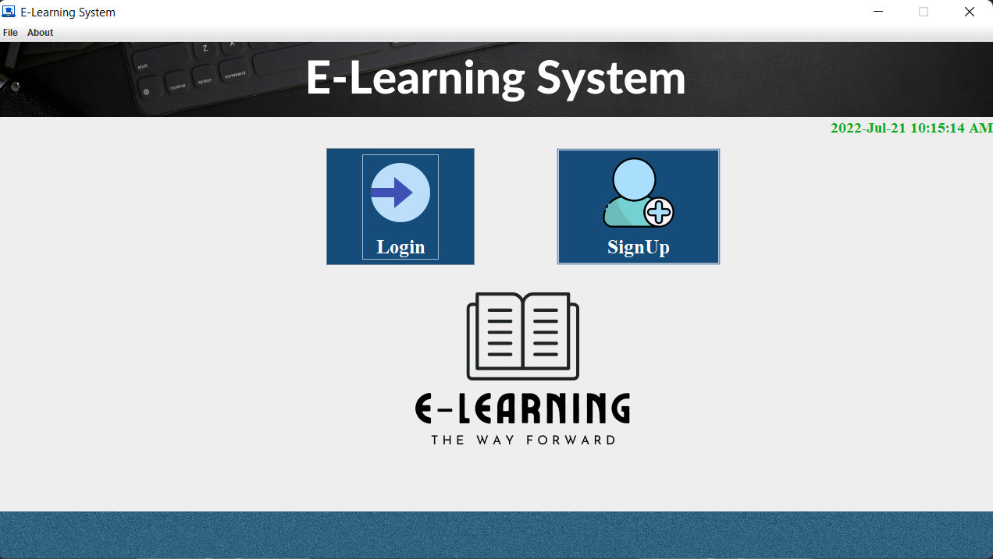

Slide 19
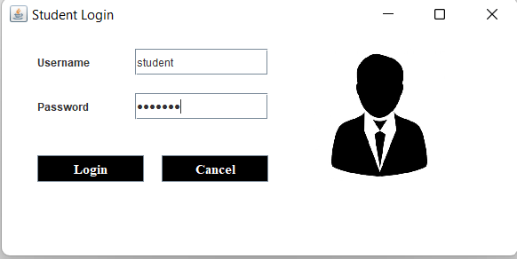

Slide 20
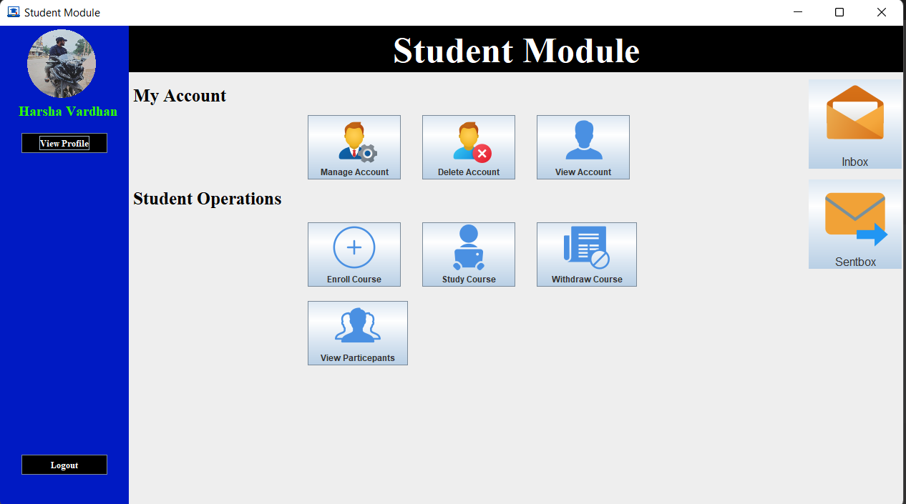

Slide 21
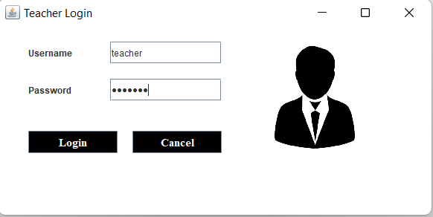

Slide 22
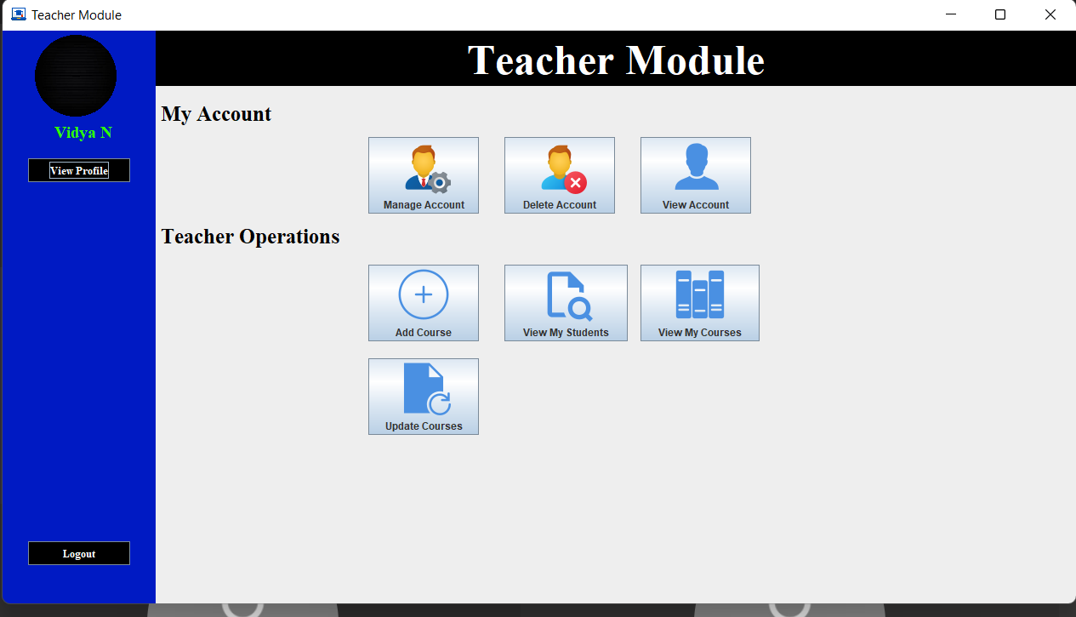

Slide 23
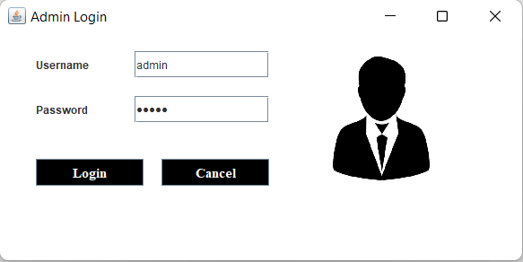

Slide 24
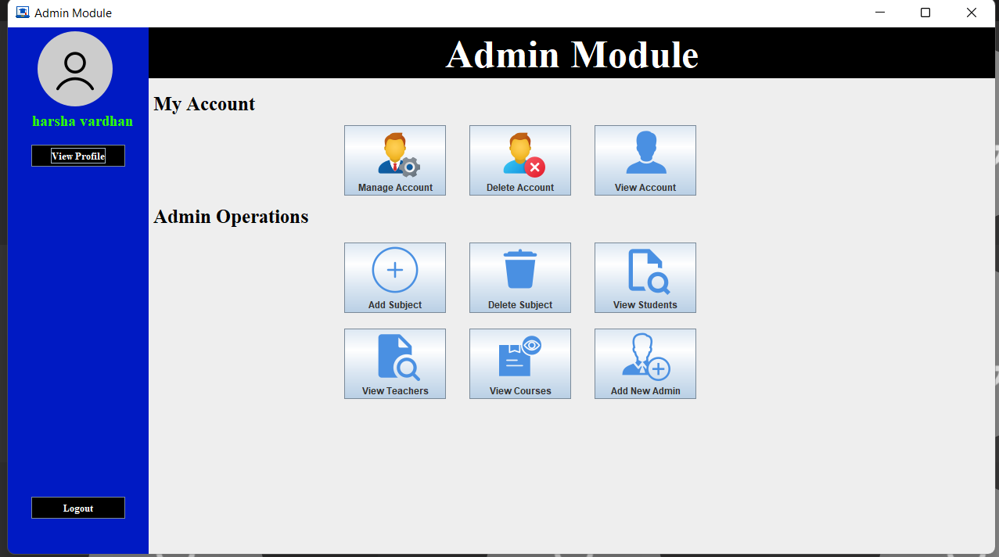

Slide 25
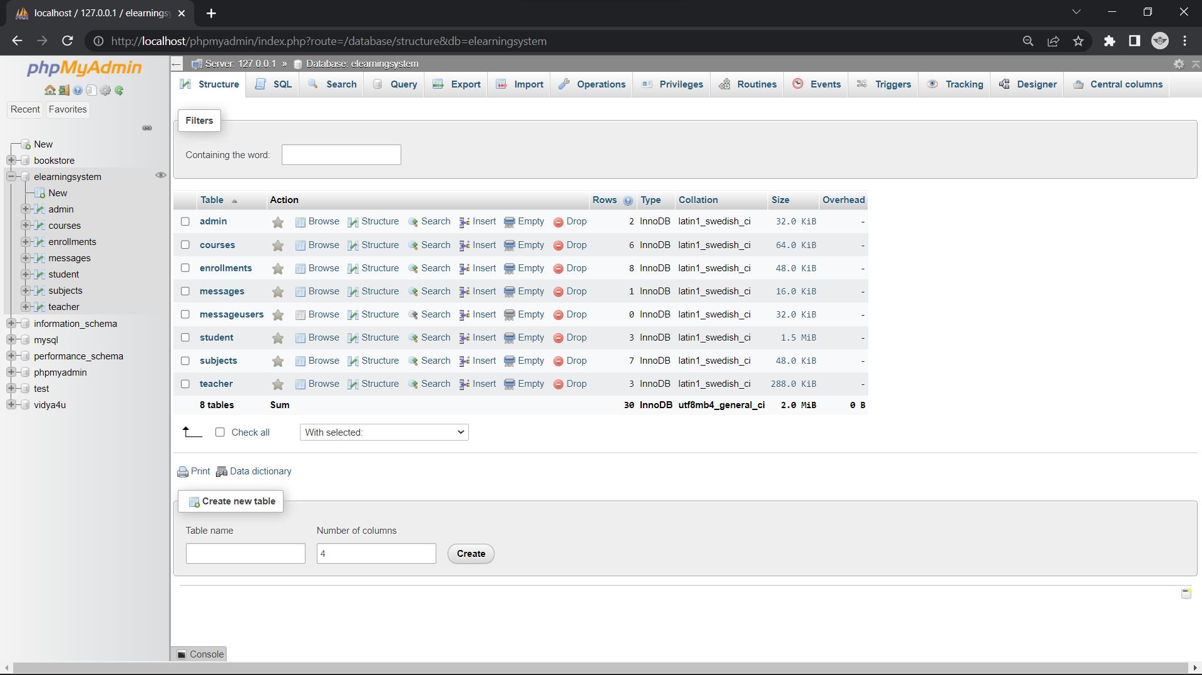
Database

Slide 26
Conclusion
E-Learning is not intended to replace conventional methods and learning in classroom.It’s aim is to create an augmented learning environment where technology is used to deliver a combined range of teaching and learning techniques aimed at maximizing the individual’s participation and achieving the goals in the learning and teaching process.

Slide 27
References
[1] https://shsu-ir.tdl.org/shsu-ir/bitstream/handle/20.500.11875/1164/0781.pdf?sequence=1
[2] https://ieeexplore.ieee.org/document/6208293/
[3] https://ieeexplore.ieee.org/document/4679917/

Slide 28


